Slide 1
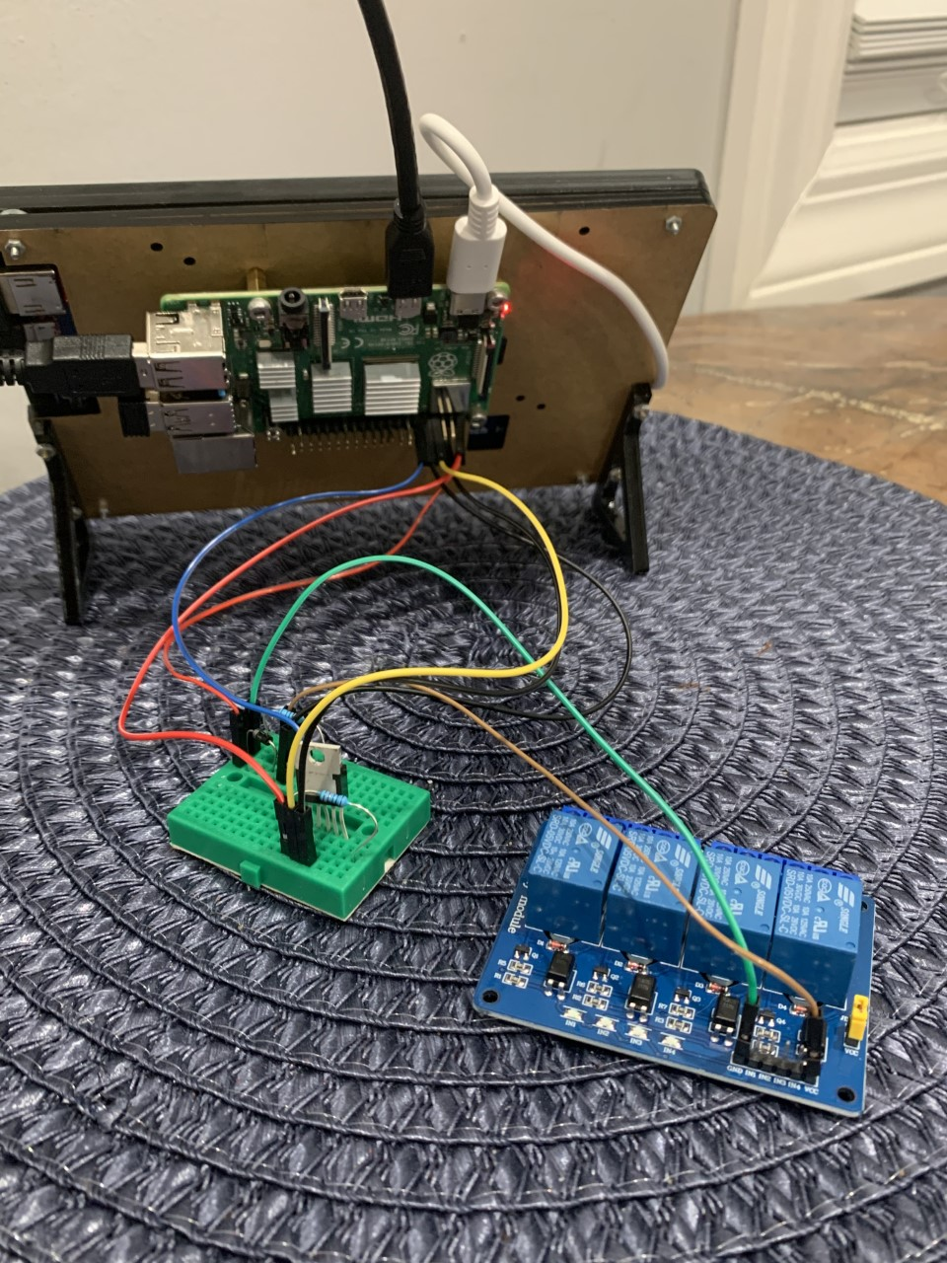
Pi Thermostat
By: Joshua Lopez
Presentation ID: 44

Slide 2
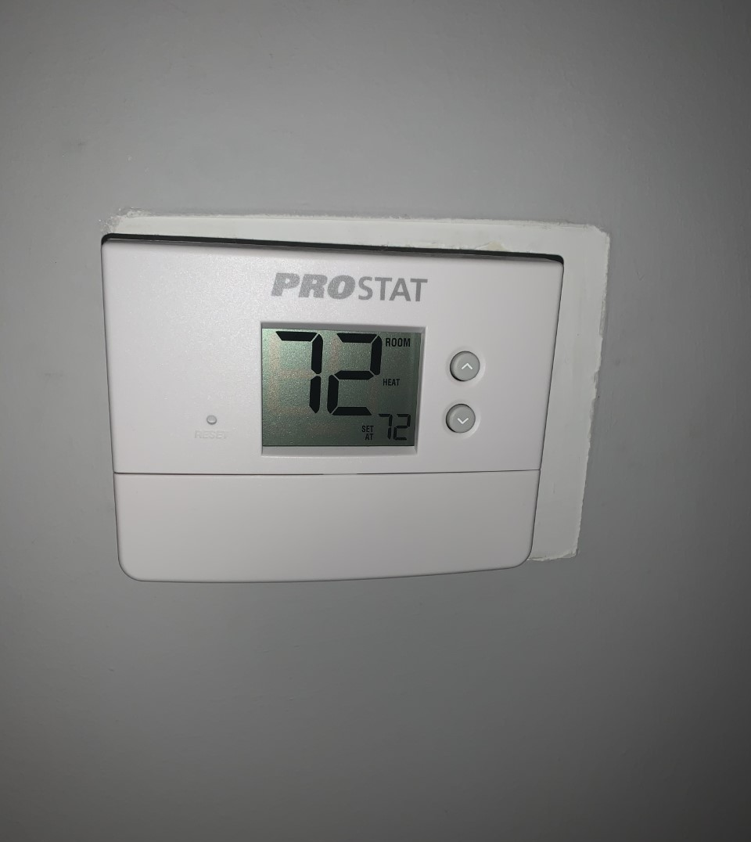
Motivation
In this project the problem trying to solved is configuring the HVAC system in my house and having the Raspberry Pi replace the thermostat we currently use
The current thermostat that I use is the Prostat 4950 non-programmable 1 heat/ 1 cool system.

Slide 3
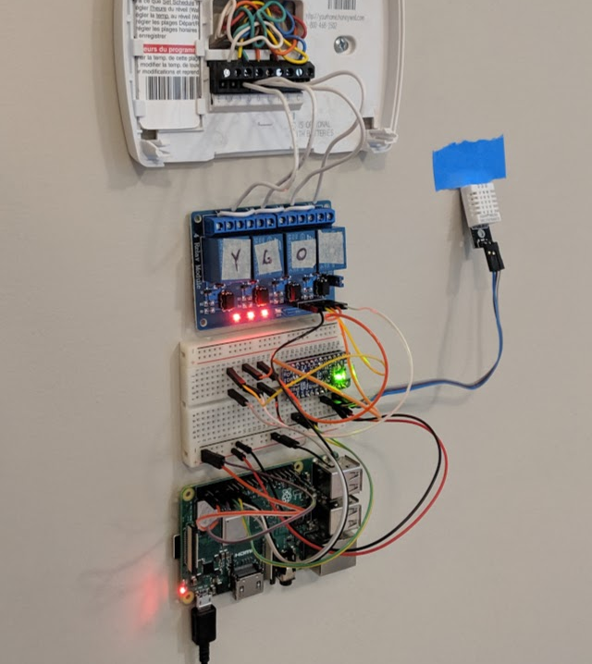
Motivation
The Raspberry Pi can be a replacement for a thermostat, and I wanted to see how that is done
One way this is done is by turning the Pi into a nest thermostat
Having a Pi as a thermostat can be cheaper than buying a regular thermostat

Slide 4
Motivation
Being able to control heating and cooling with a Raspberry Pi is important because learning how to will give the insight needed when dealing with HVAC systems and how to control them
I thought that this project was a great idea because it seemed like a challenge that I wanted to tackle because of how much one can learn about how temperature is monitored around the environment

Slide 5
Challenges
There were many challenges when facing this project
The biggest problem was dealing with connecting the Pi to the HVAC system
If not done correctly this can cause injuries or death
Having an electrician or plumber deal with connecting the Pi to the thermostat would be ideal
There were many wires involved and ensuring the correct resistance was vital as well as what to connect to the wall, so it is safely implemented

Slide 6
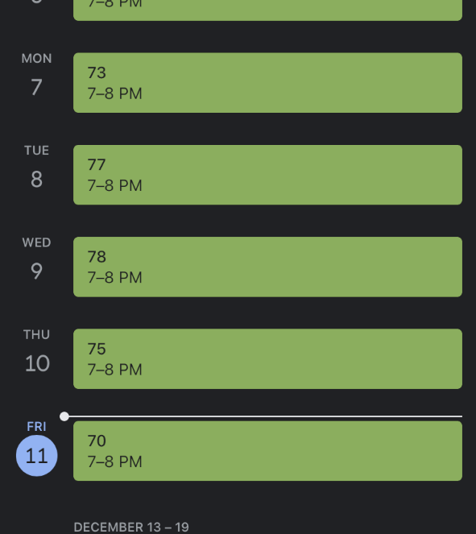
Architecture
In order to do this project, I first wanted to download IFTTT, which does conditional statements based off changes that occur in web services such as Gmail.
Using Google calendar, I added repeating events for IFTTT
In this case using the Raspberry Pi to read the temperature using the DS18B20, and then when the temperature would drop IFTTT would detect it using their source, and with it take the repeating events from Google Calendar with the desired temperature as the title and send it to my Gmail account, which then the Pi would read from Gmail.

Slide 7
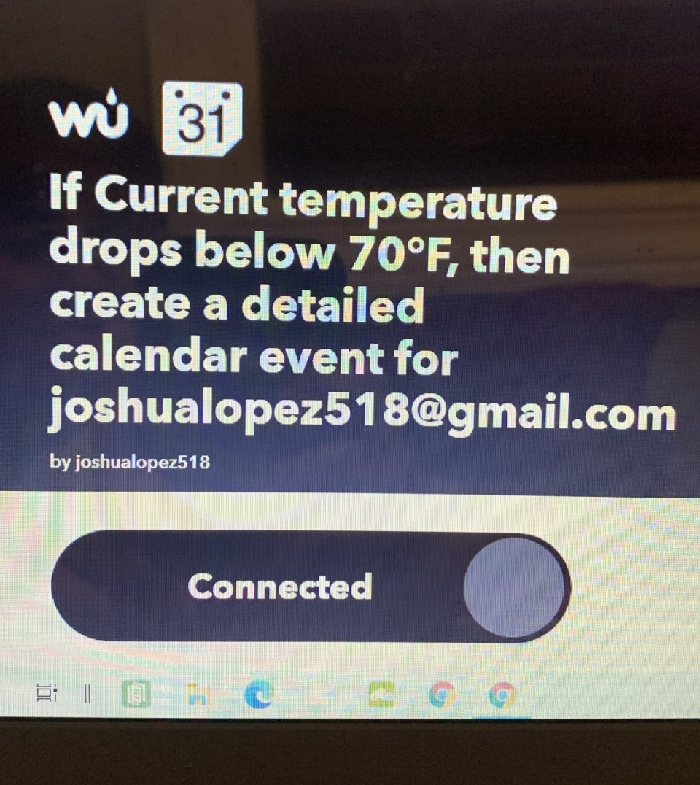
Architecture
You can set the temperature manually using IFTTT, by having it send the desired temperature as the subject to your Gmail account, which the Pi will then read
I needed a diode, transistor, digital thermometer, relay module, two resistors(10K and 1K) and an Adafruit Pro-Trinket to do this project

Slide 8
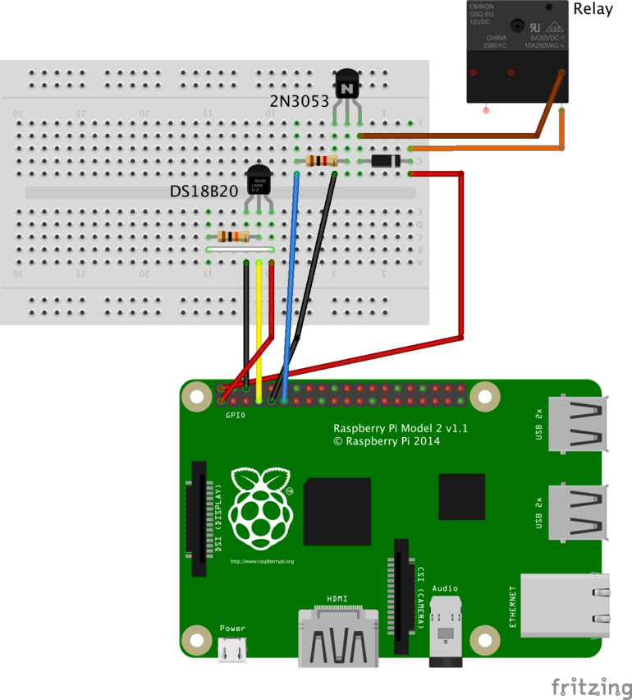
Architecture

Slide 9
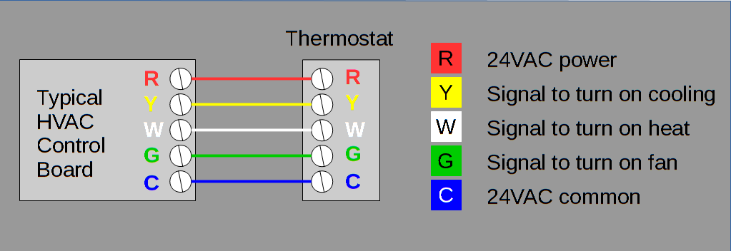
Architecture
The thermostat is wired with red white yellow and green colors
The red wire is the 24V AC power, white wire is the heat, yellow wire is the cooling, and the green wire is the indoor fan
The relay module connects to these wires in the thermostat

Slide 10
Architecture
Using Python, I imported email so the pi could read the Gmail events
Used read temp methods to read the temperature and convert to Fahrenheit and then ultimately print the current temperature and read the Gmail event.
In the code I used mod probe w1-gpio and mod probe w1-therm to find the temperature from the thermometer
Having the connected relay and running the program would result in temperature regulation in my house

Slide 11
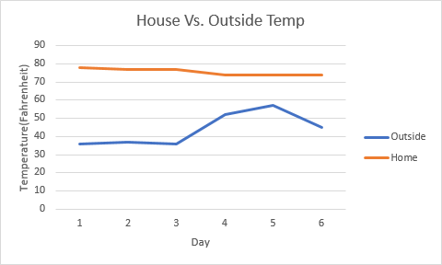
Evaluation
I did not manage to finish this project because it is not advised to attempt to do this without an electrician or plumber, mains voltage can be very dangerous.
While I did obtain all the materials needed. I did not connect it to the thermostat
I plan on continuing this project as I get more assistance on removing the thermostat and plugging in the relay

Slide 12
Discussion
Overall, I feel like I learned how difficult it can be to implement a thermostat into a house and how it takes multiple materials and coding to make sure the Pi is able to deliver the temperature changed need. I feel like we can also learn that when done carefully the Pi is a great replacement for a home automation tool as it can be used in a variety of ways, temperature control only being one aspect.

Slide 13
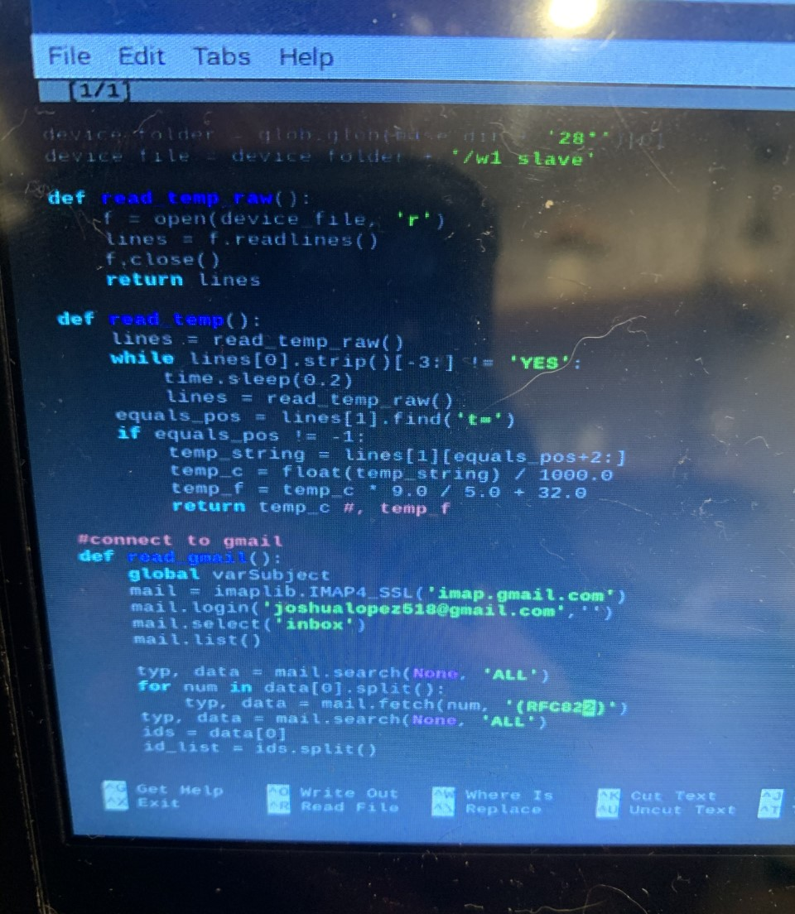
Discussion
The code to login to my Gmail

Slide 14
Thank You!
Any questions or comments are welcomed

